Slide 1
Colegio Monterei de Pila Grading System
Marc Dave Mendoza
Project Manager/Developer
Angelo Costales
Cerjei Jan Canamaque
Jhun Michael Tabudlong
Project Developers/ Document Editors

Slide 2
Cleint Background
The Colegio Monterei de Pila started as the Community Children’s House in 1979. The CCH was housed in a two-storey residential building owned by the Maceda family in the town of Pila. The ground floor served as classrooms and the upper floor as office and residence of the founder of the school. Edna Cambe Monreal and her family. The school was inaugurated on August 31, the birth date of Maria Montessori whose philosophy and teaching methods were adopted by the school because Edna had trained as a Montessori teacher at the Operation Brotherhood Monterei Center in Metro Manila. Before that, she was a public school teacher.

Slide 3
System Overview
The system is to have a collaborative means of communication with the faculty, wherein they could upload the grades and have an easy access to view it with the other subject teachers and advisers. Thus, helping them to compute the grades faster. The students and parents will also have an access to the system to view the grades quarterly.
Online grades is to be done for the use of teachers in Colegio Monterei de Pila strengthen data integrity and to lighten work for the people who work on student's grades in the school. One of the major feature of the project is having the teachers update the quarterly grade of the student, the grade can be viewed by the parents/students online.

Slide 4
Project Objectives
Online grades is to be done for the use of teachers in Colegio Monterei de Pila strengthen data integrity and to lighten work for the people who work on student's grades in the school. One of the major feature of the project is having the teachers update the quarterly grade of the student, the grade can be viewed by the parents/students online.
Project Objectives
Short Term:
1. To provide an online grade viewer which is faster and easier.
2. Assurance of data consistency and integrity.
3. Automated process will lessen the manual work.
Long Term:
1. An organized data information.
2. Maintaining past student grade records.

Slide 5
Scope and Limitation
Scope
Colegio Monterei de Pila online grade viewing project will be implemented in CMP itself. The project will provide efficient way on how to view grades through online that will be a useful tool to all target users. It will provide services such as viewing information about the student online (grades, section, subjects, schedule) input grades by teachers, and editing the system by administrators (tech. support, registrar’s office) This is a long term project for CMP when its implemented, and it can be improve from time to time by the technical support of the school.
Limitation
Parent and student can only view the uploaded grade on the website.

Slide 6
Event Table
Event | Trigger | Source | Use Case | Response | Destination
Inquires about the school requirements | School Inquiry | Admission’s office | School requirements inquiry for enrollment | Interview with the parent | Parent
Parent complies with the school requirements | Assessment examination | Admission’s office | The enrollee will take the assessment exam and an interview | Completed both exam and interview | Admission’s office
Parent complies with the tuition fee of their child | Tuition fee | Registrar | Paying the tuition fee of the enrollee | The new enrollee will be added to the system’s database | Parent
Views the school facilities | Facility reviewing | Parent/Student | Parent will now view the school facilities through the use of the school website | School photo galleries will be shown to the viewer | Parent/Student
Parent can view their child’s grade using the school website | Online grade viewing | Parent | Inquires about the student’s grade | Shows the quarterly grades of the student | Subject Teacher
Parent
Parent

Slide 7
Teacher
Event | Trigger | Source | Use Case | Response | Destination
Teacher will compute the final grade of the student | Grade computation | Teacher | Computing the grades of the student | Computed final grade | Parent/Student
Teacher will upload the computed grades on the system | Grade submission | Teacher | Uploading of the final grades on the online system | Student grade will be shown to the school online system | Parent/Student

Slide 8
Student
Event | Trigger | Source | Use Case | Response | Destination
Student will Login on the online system | System login | Student | Login on the online system | Student account will be shown | System
Student will do an online grade viewing | Grade inquiry | Student | Online grade viewing | Final grade will be shown | System

Slide 9
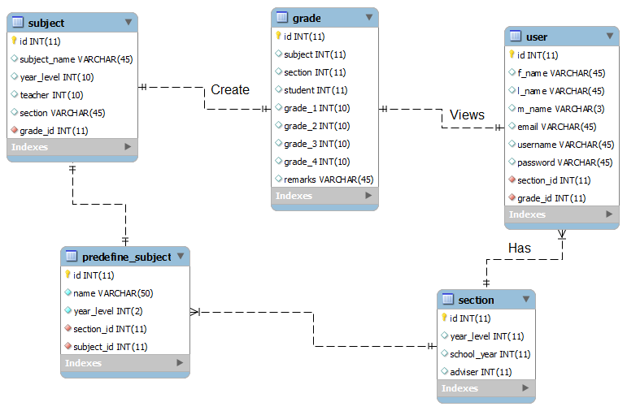
Entity Relationship Diagram

